Slide 1
Food Deserts and Food Insecurity
Denise Meeks
GLO 599 Independent Study
Spring 2024
Project:
http://denisemeeks.com/journalism/glo_599/

Slide 2
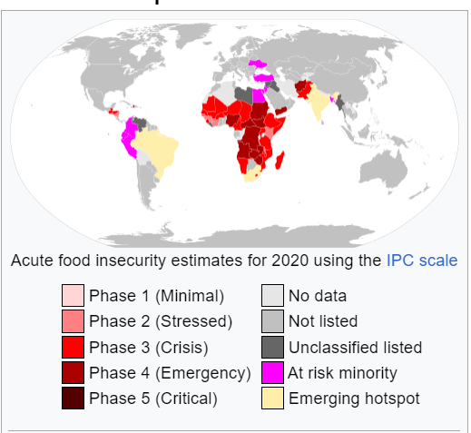
Introduction
Between 1975 and 2023 the world's population nearly doubled https://www.worldometers.info/world-population/
By 2050 the world will need to feed more than 9 billion people https://nca2014.globalchange.gov/report/sectors/agriculture#intro-section-2
Agricultural improvements alone cannot alleviate food insecurity
Violence, prejudice, disinformation, disease and lack of technology, funding and clean water all contribute to hunger and malnutrition, which disproportionally affect the marginalized groups
Image source: Food insecurity, ArcMachaon, Jul. 13, 2020 Wikipedia food security during the COVID-19 pandemic https://en.wikipedia.org/wiki/Food_security_during_the_COVID19_pandemic#/media/File:Acute_food_insecurity_forecast_for_2020_including_coronavirus_famines.svg CC BY-SA 4.0

Slide 3
Food insecurity and food deserts
Food insecurity: the limited or uncertain availability of nutritionally adequate and safe foods, or limited or uncertain ability to acquire acceptable foods in socially acceptable ways
Food deserts: areas with high poverty rates and low access to grocery stores and nutritious food
https://www.medicalnewstoday.com/articles/what-are-food-deserts
Image source: Sugary, high calorie snacks are components of a food desert D. Meeks, Walmart, Tucson, Arizona, Jan. 18, 2024, CC BY-SA 4.0

Slide 4
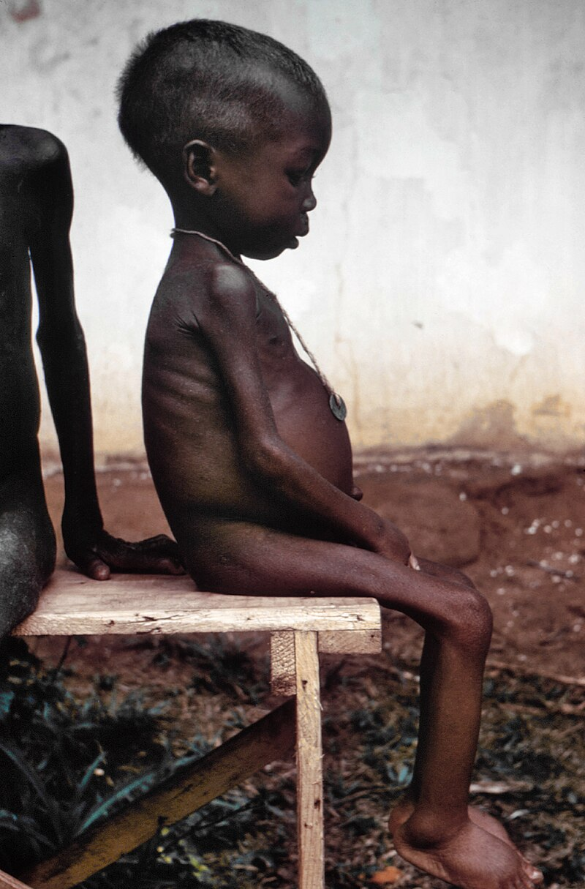
Conflict, climate change, natural disasters and pandemics
Conflict is the major cause of hunger, destroying transportation systems, driving inflation and causing violence when groups compete for resources
https://www.wfpusa.org/articles/global-food-crisis-10-countries-suffering-the-most-from-hunger/
70% of the world's hungry population live in areas of war and violence
https://www.wfp.org/global-hunger-crisis
Climate change affects health and safety, life quality, economic growth, food production, water resources, energy distribution, transportation, public health, international trade and national security
https://nca2018.globalchange.gov/downloads/NCA4_Ch01_Summary-Findings.pdf
Natural disasters, including tsunamis, earthquakes, hurricanes, tornadoes, wildfires, floods and insect swarms also have major effects on food distribution networks and hunger
https://www.paho.org/en/health-emergencies/food-and-nutrition-disasters,
https://www.azolifesciences.com/article/Investigating-the-Impact-of-Disasters-on-Food-and-Agriculture.aspx
Discrimination, inequitable distribution of federal funding, poor infrastructure and inadequate access to nutritious food are made worse by pandemics, including COVID-19
https://www.feedingamerica.org/sites/default/files/2021-03/National%20Projections%20Brief_3.9.2021_0.pdf
Image source: Starved girl found in a relief camp during the Nigerian-Biafran war, L. Conrad/CDC, Late 1960s, Wikipedia malnutrition https://en.wikipedia.org/wiki/Malnutrition#/media/File:Starved_girl.jpg, public domain

Slide 5
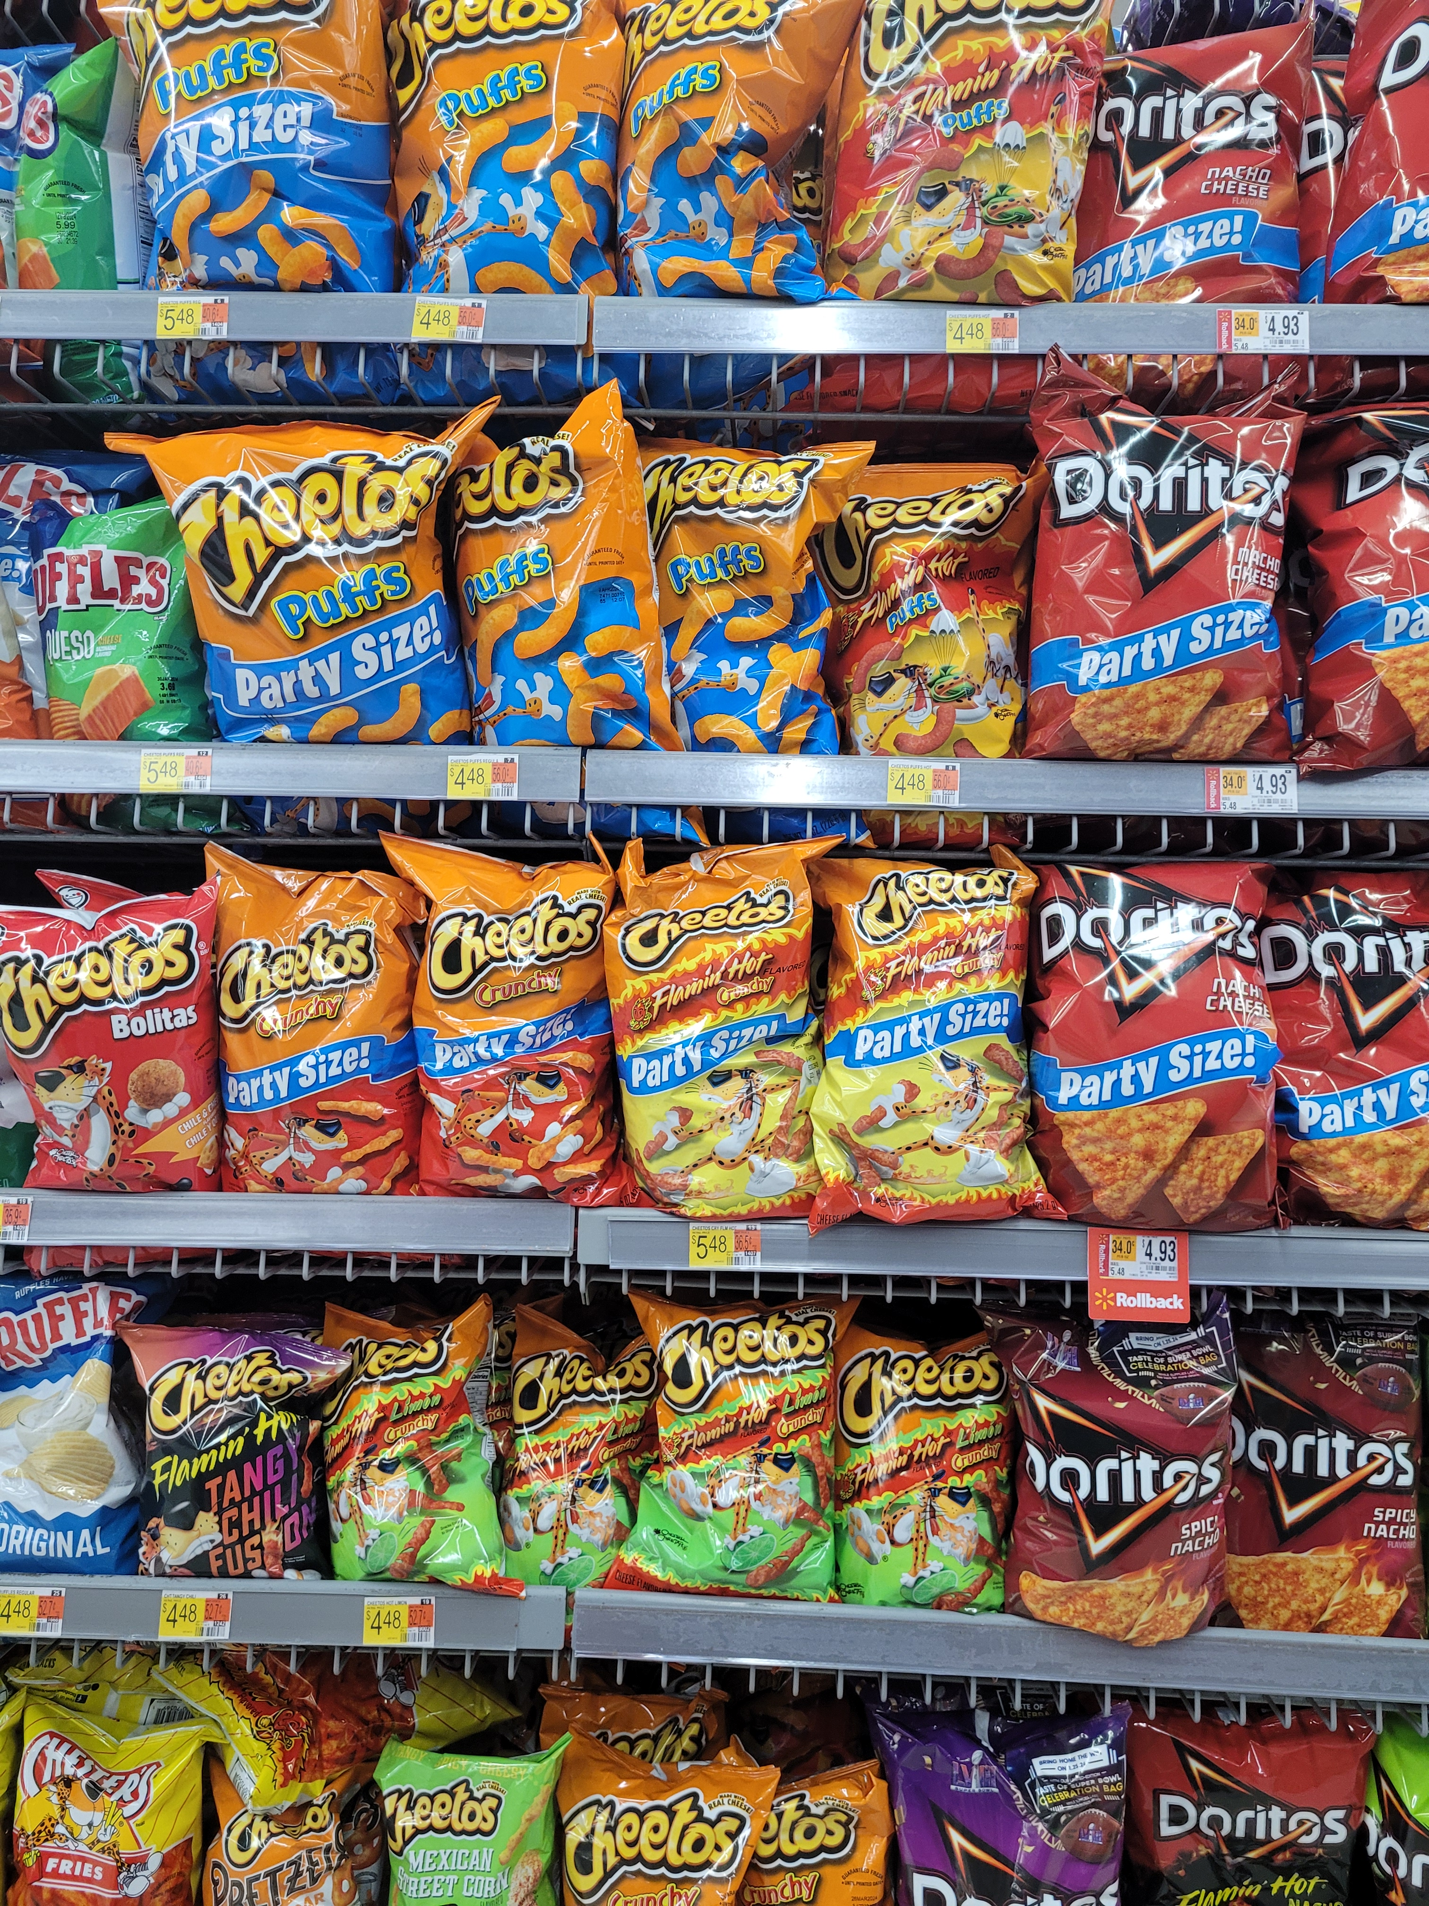
Nutrition and Health
20% of young people aged 2 to 19 years and 42% of adults are obese, putting them at risk for heart disease, type 2 diabetes and some cancers
Two of the leading causes of heart disease and stroke are high blood pressure and high cholesterol
Unhealthy diet is responsible for up to 45% of all cardiometabolic disease deaths
Current sodium guidelines recommend getting less than 2,300 milligrams a day, but the average American consumes more than 3,400 milligrams per day
More than 70% of the sodium that Americans eat comes from packaged, processed, store-bought and restaurant foods,
Source: https://www.cdc.gov/chronicdisease/resources/publications/factsheets/nutrition.htm,
https://journals.plos.org/plosmedicine/article?id=10.1371/journal.pmed.1002981
Image source:Crunchy snacks are convenient but not a replacement for fruit and vegetables, D. Meeks, Walmart, Tucson, Arizona, Jan. 18, 2024 CC BY-SA 4.0

Slide 6
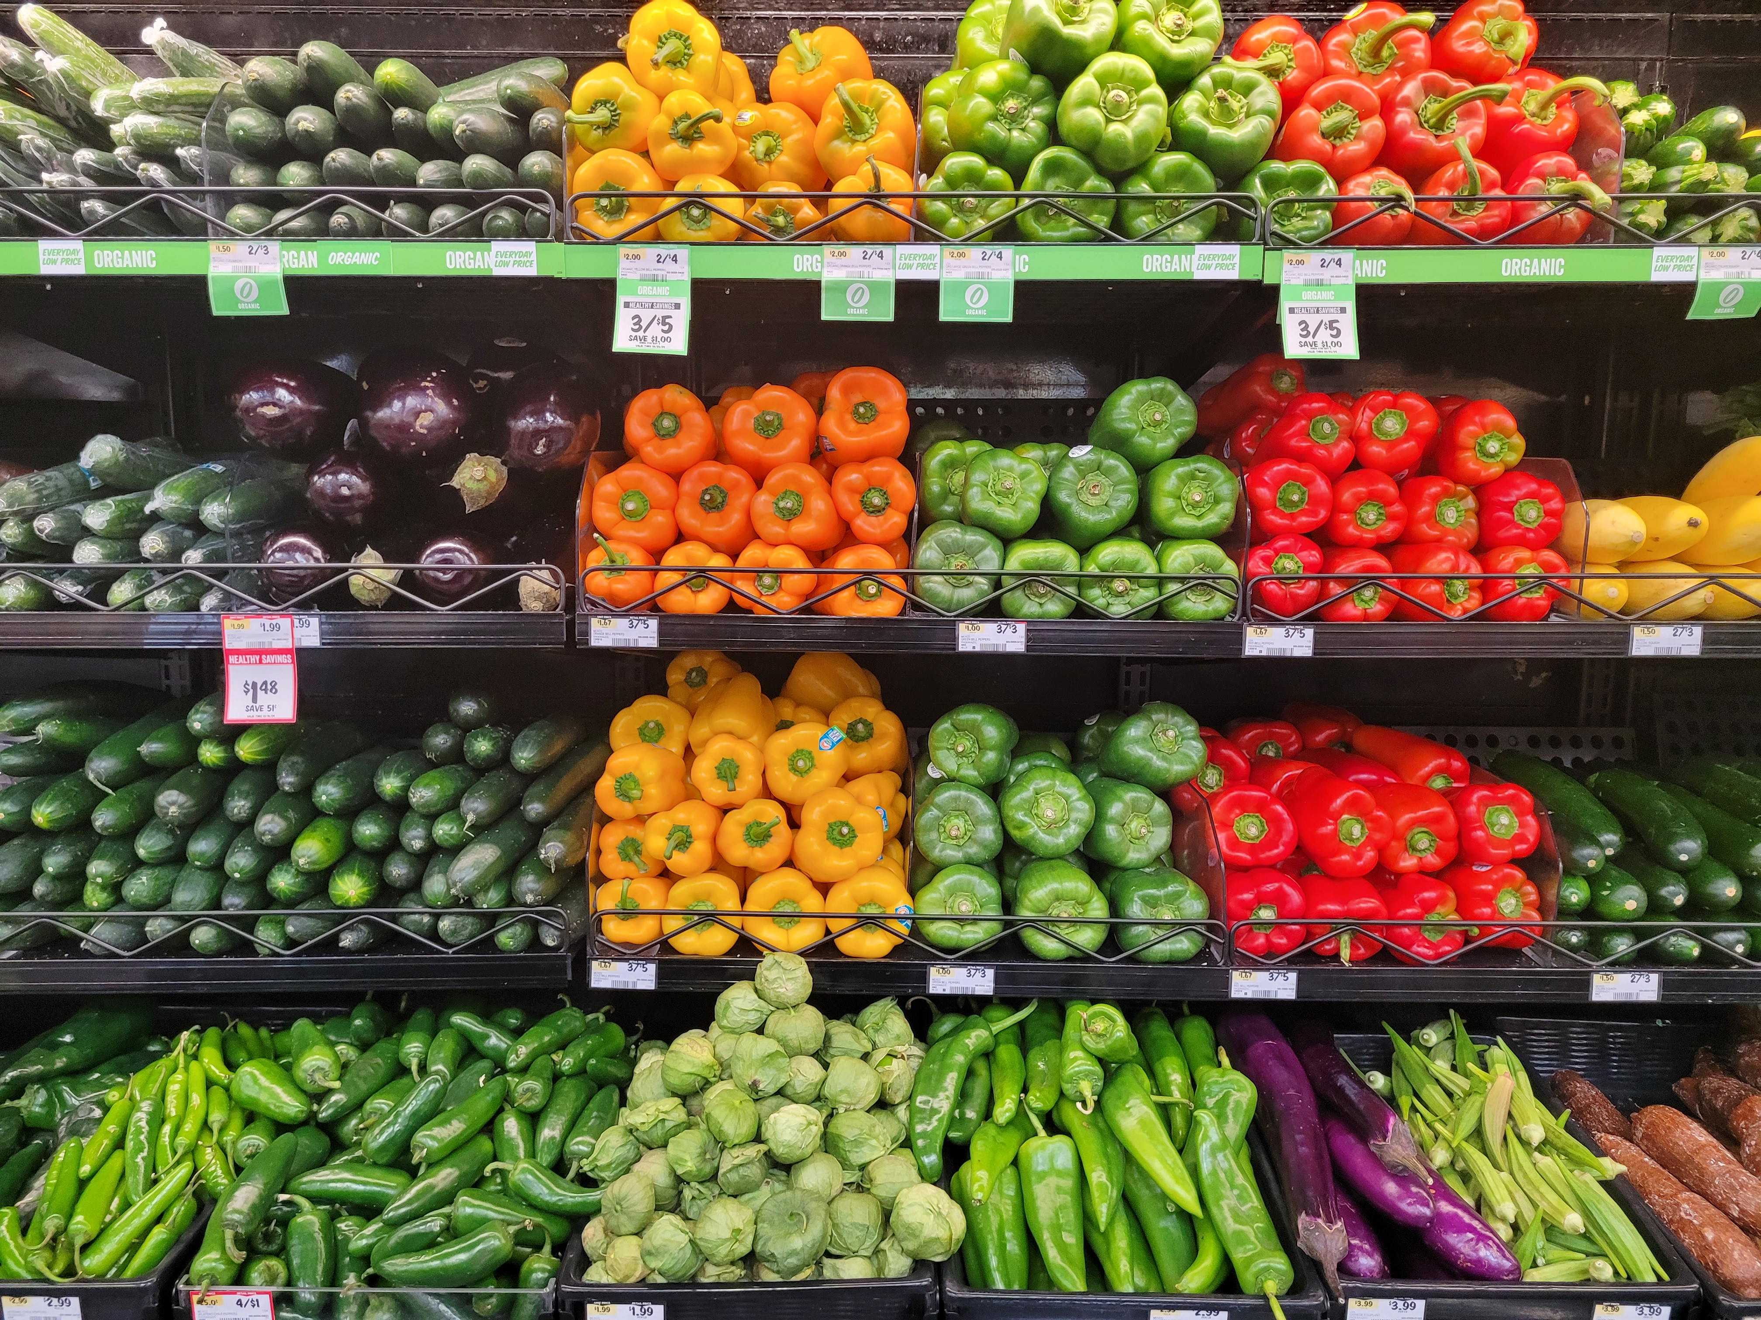
Food security and education
Nutrition education is related to better health, improved financial security and a higher quality of life
https://www.ers.usda.gov/webdocs/publications/42711/12716_ap036_1_.pdf
Food nutrition labels, removal of unhealthy foods from school and work environments, calorie information in fast food outlets, food literacy programs and public service ads can be used to educate consumers
https://academic.oup.com/heapro/article/30/suppl_2/ii77/645595?login=false
Promoting healthy food options in corner convenience stores in underserved areas increased the sales of fruits and vegetables and improved diets of vulnerable populations
https://www.ers.usda.gov/webdocs/publications/42711/12716_ap036_1_.pdf
Increasing healthy food options doesn’t necessarily show an immediate benefit of eliminating food deserts because of poor food choices
https://www.canr.msu.edu/news/food-insecurity-and-food-deserts-how-are-they-related
Programs providing school meals, teacher training, parental education can improve nutrition and eating habits
https://apps.fas.usda.gov/newgainapi/api/Report/DownloadReportByFileName?fileName=A%20Success%20Story%20-%20USDA-FAS%20McGovern-Dole%20and%20Save%20the%20Children%27s%20PALAM-A%20Project%20is%20Feeding%20Thousands%20of%20School%20Kids%20in%20Sri%20Lanka_Colombo_Sri%20Lanka_CE2022-0016.pdf
Image source: Vegetables are a healthy choice,
D. Meeks, Sprouts, Tucson, Arizona, Jan. 18, 2024 CC BY-SA 4.0

Slide 7
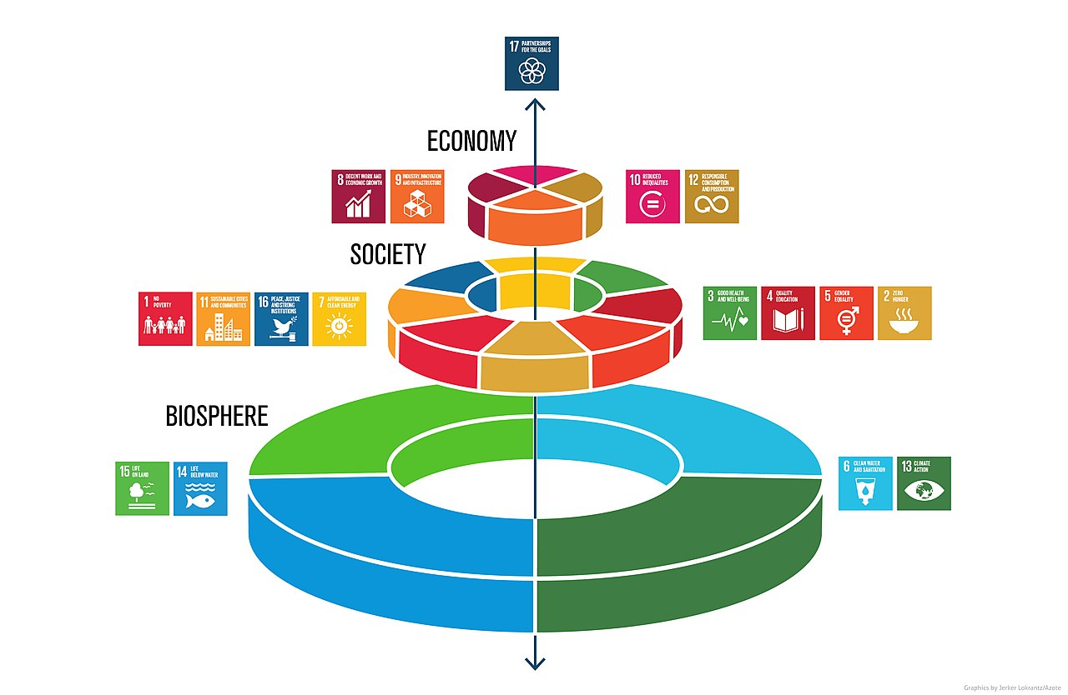
Solutions
United Nations organizations, International Red Cross Committee, USAID and U.S. Bureau for Humanitarian Assistance and other organizations provide nutrition education and agriculture technology infrastructure which are most effective when they address the specific agricultural and cultural needs of a population
https://www.foodassistanceconvention.org/downloads/sumrec/fac2022nr.pdf
Federal and state programs, including SNAP, WIC and others aimed at helping the poor, women, children and minorities, allow individuals to purchase nutritious food and improve health and wellbeing
https://www.feedingamerica.org/take-action/advocate/federal-hunger-relief-programs,
https://www.fns.usda.gov/programs
Local solutions, including food banks and community gardens, frequently provided by volunteer organizations, are often best at addressing the social, political, economic and cultural needs of a community
Image source: U.N. Sustainable Development Goals, Azote, Stockholm Resilience Centre, Stockholm University Jun. 13, 2006 Wikipedia earth https://en.wikipedia.org/wiki/Sustainable_Development_Goals#/media/File:SDG_wedding_cake.jpg CC BY 4.0

Slide 8
Observations and Conclusions
Hunger and food insecurity are complicated, widespread international problems affected by economic, political and social issues, including conflict, climate change, natural disasters and pandemics
The poor, women, children and minorities disproportionally suffer from food insecurity because of inequities in agriculture, food distribution and clean water systems
Poor nutrition leads to chronic diseases, disability and early death, reduces quality of life, stresses social welfare and health care systems
Individuals and families need long-term nutrition education to change eating habits and convenient access to healthy food
While international, national and state efforts to provide healthy food and nutrition education are necessary to reducing hunger and food insecurity, local efforts that address the needs and reflect the cultural practices of communities are critical
If and when marginalized groups are given access to resources and education, hunger and food insecurity can be significantly reduced,
Image source: CGT`s Mansfield Garden, D. Meeks
2000 North 4th Ave, Tucson, Arizona, Feb. 1, 2024 CC BY-SA 4.0

